Slide 1

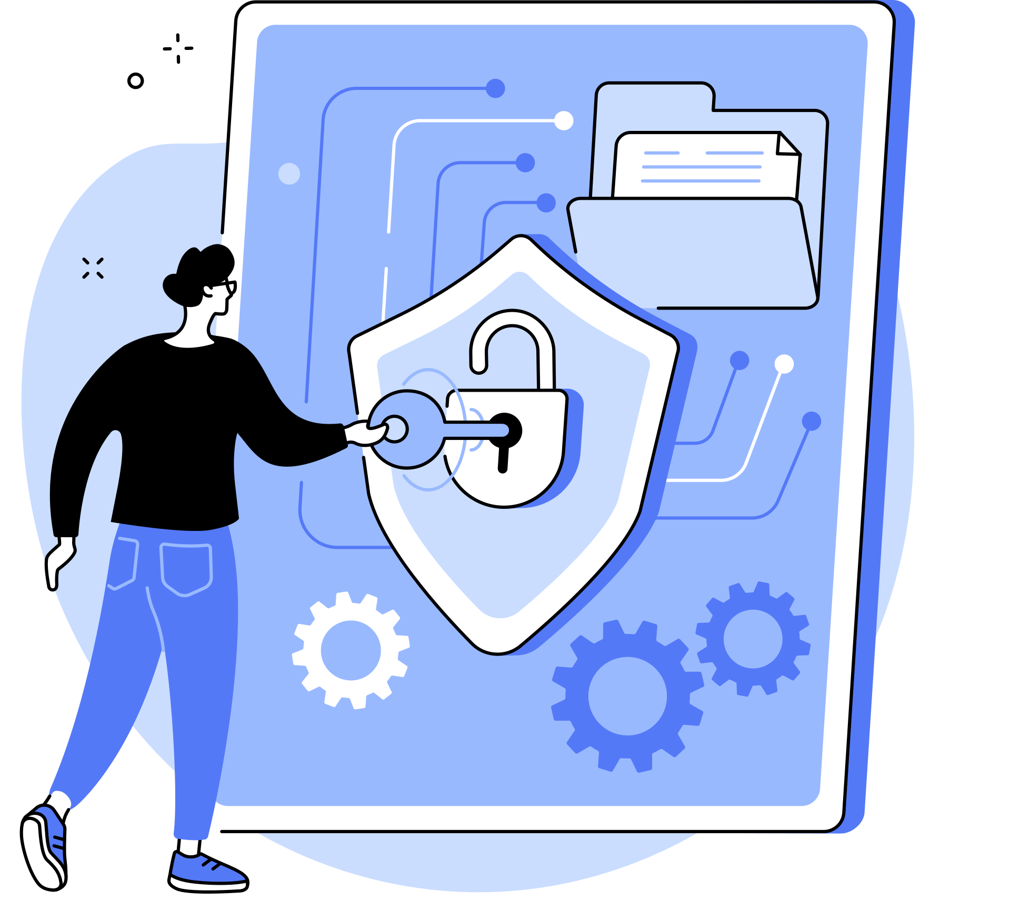

Women In Tech DXB & AI Safety
Lightning Talks: AI Safety & Women's Digital Rights
WiFi: Coders HQ Guest
NEXT

Slide 2

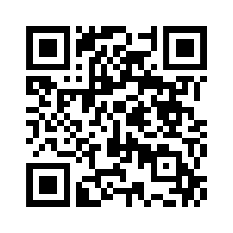

About Women in Tech Dubai
WITDXB is a volunteer run, UAE based professional group aimed at creating a safe space for women in the tech field.
We host workshops, panel events & do talks like this a lot. All of them run by and featuring inspiring women! :)
ok
Scan to get info about upcoming WITDXB meetups!
NEXT

Slide 3

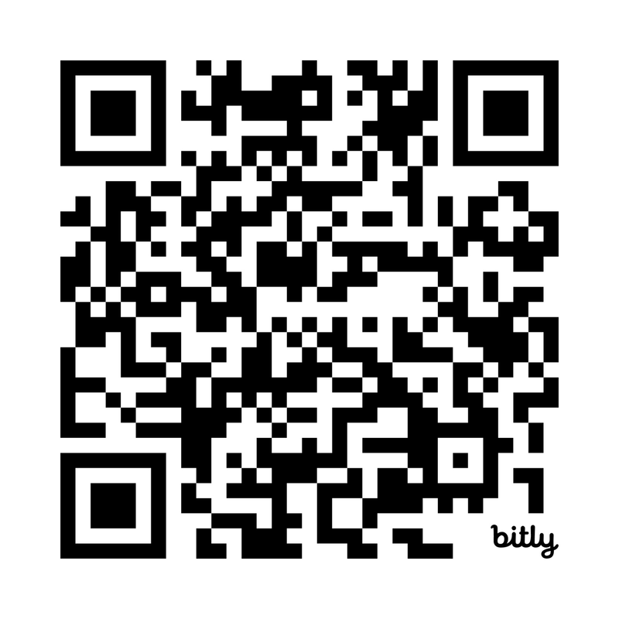
About AI Safety UAE
A community to explore AI safety and AI governance built for organisations operating in the UAE: aisafety.ae
ok
Scan to join the community!
NEXT

Slide 4
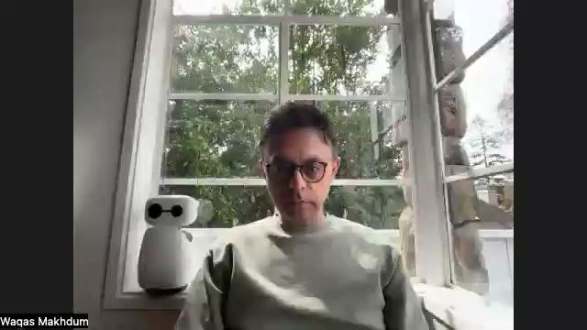
About Nebius
ok
NEXT

Slide 5


Safety Reminders
1. Emergency/Fire Exits: Emirates Towers Boulevard exits that you'd use to enter the space.
2. Alert Protocols: Stay calm, and stay indoors - we have security on the ground that will advise if we need to do anything else. You are safe here :)
ok
NEXT

Slide 6

Agenda
🌙 Prayer Times
6:31pm - Maghrib
7:44pm - Isha
6:00 PM - 7:10 PM: Welcome, Iftar, and Networking
7:15 PM - 7:30 PM: Introductions by WiTDXB, AI Safety UAE, and Nebius
7:30-7:40 PM: Designing Digital Autonomy by Mumtaz Kynaston-Pearson
7:40-7:50 PM: AI Risk Threshold Analyzer by Swaleha Parveen
7:50-8:00 PM: Trust & Disinformation on Social Media by Raheeza Khan & Divya Unnikrishnan
8:00-8:10 PM: Safety-by-Design in Healthcare AI by Maria Tepegjozova
8:10-8:20 PM: Making AI Governance Work by Eva Mathur
8:20-8:30 PM: Operationalising AI Governance in UAE by Madhumita Bose
8:30 PM - 8:40 PM: Consolidated Q&A Session
8:40 PM - 9:00 PM: Closing & Networking
NEXT

Slide 7


Women In Tech DXB & AI Safety
Scan to join Women In Tech DXB!
Scan to join AI Safety UAE!

Slide 8


Women In Tech DXB & AI Safety
Your feedback is important to us

